Slide 1

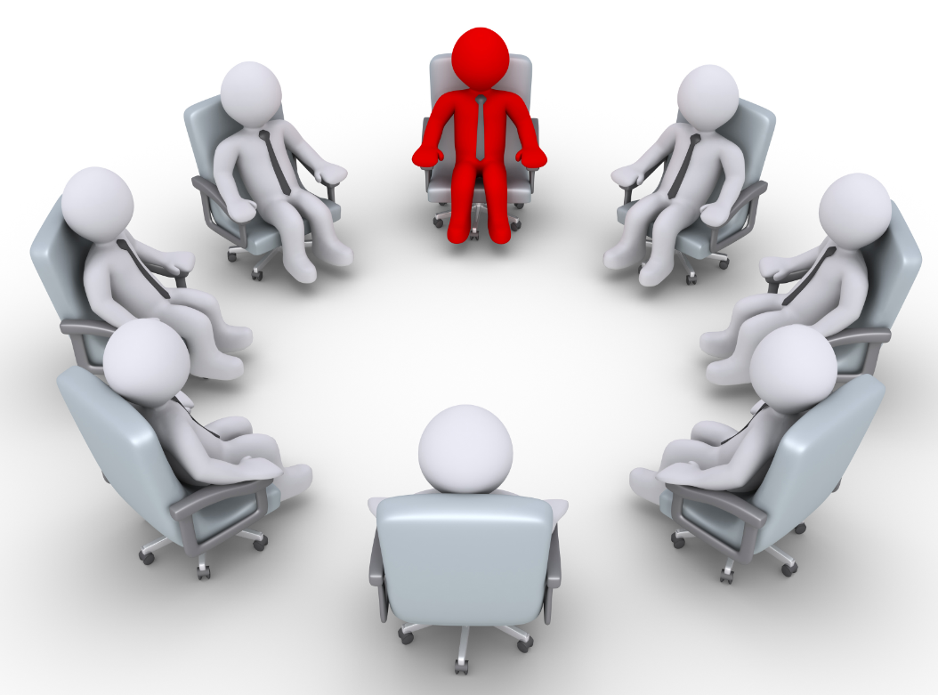
PRINCIPLES OF MOTIVATION LEADERSHIP COMMUNICATION
SPRING 2023
CHAPTER 09
FAREED QURESHI

Slide 2
SESSION OBJECTIVES
Act as a communication champion rather than just as an information processor.
Use key elements of effective listening and understand why listening is important to leadership communication.
Recognize and apply the difference between dialogue and discussion.
Select an appropriate communication channel for your leadership message.
Use communication to influence and persuade others.
Effectively communicate during times of stress or crisis.

Slide 3
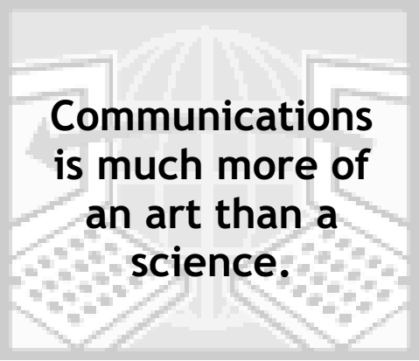
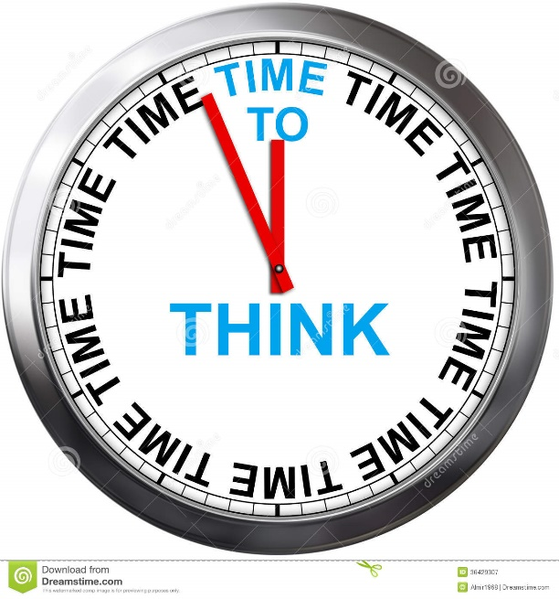

Slide 4
SOME BASICS
People are not their words and behavior.
Context is what determines others’ interpretation of any action or communication.
Actions do not necessarily represent intentions.
Two people will see the same thing in entirely different ways.
People respond in accordance with their own interpretation of reality – maps
If you always do what you always did, you will always get what you always got.
Success depends on varying what you do until you get the result that you want.
People with the greatest choice and flexibility of behavior come out on top.
It is impossible not to communicate.

Slide 5
WHAT IS COMMUNICATION?
A process by which information and understanding are transferred between a sender and a receiver

Slide 6
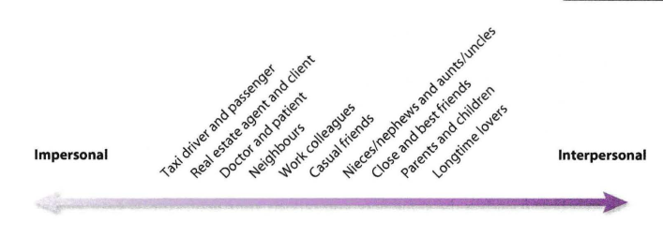
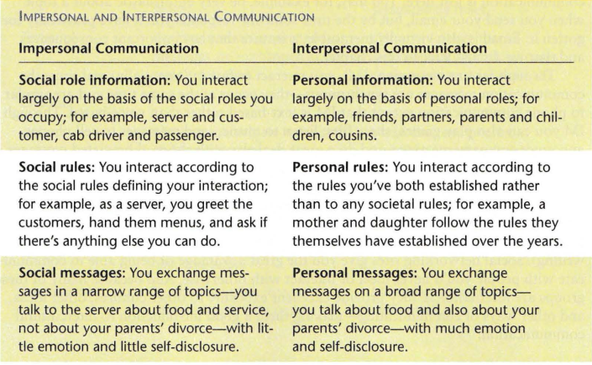
THE CONTINUUM OF COMMUNICATION

Slide 7
TRUE OR FALSE?
Good communicators are born, not made.
The more you communicate, the better you will at communicating.
In your interpersonal communications, a good guide to follow is to be as open, empathic, and supportive as you can.
In intercultural communication, it is best to ignore the differences and communicate just as you would with members of your own culture.
When there is conflict, your relationship is in trouble.

Slide 8
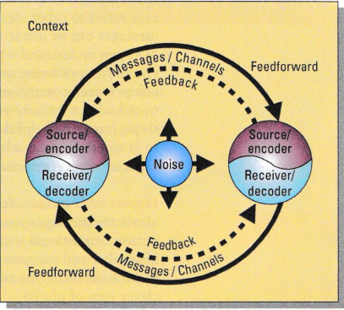
BASIC MODEL OF COMMUNICATION PROCESS

Slide 9
THE LEADER AS A COMMUNICATION CHAMPION
Purpose Directed
Direct attention to vision/values, desired outcomes; use persuasion
Strategic Conversation
Open climate
Listening
Discernment
Dialogue
Leader
as Communication Champion
Internal and external sources
Methods
Use rich channels
Stories and metaphors
Informal communication

Slide 10
WHY OPEN THE COMMUNICATION CHANNELS?
An open climate is essential for cascading vision, and cascading is essential because:
Natural Law 1: You Get What You talk about
A vision must have ample ‘air time’ in an organization. A vision must be shared and practiced by leaders at every opportunity.
Natural Law 2: The Climate of an Organization is a Reflection of the Leader
A leader who doesn’t embody the vision and values doesn’t have an organization that does.
Natural Law 3: You Can’t Walk Faster Than One Step at a Time
A vision is neither understood nor accepted overnight. Communicating must be built into continuous, daily interaction so that over time followers will internalize it.

Slide 11
BARRIERS TO EFFECTIVE LISTENING
Distractions: Physical and mental
Biases and prejudices
Lack of appropriate focus
Premature judgment

Slide 12
KEYS TO EFFECTIVE LISTENING
Keys | Poor Listener | Good Listener
1. Listen actively | Is passive, laid back | Asks questions; paraphrases what is said
2. Find areas of interest | Tunes out dry subjects | Looks for opportunities, new learning
3. Resist distractions | Is easily distracted | Fights distractions; tolerates bad habits; knows how to concentrate
4. Capitalize on the fact that thought is faster than speech | Tends to daydream with slow speakers | Challenges, anticipates, summarizes; listens between lines to tone of voice
5. Be responsive | Is minimally involved | Nods; shows interest, positive feedback

Slide 13
KEYS TO EFFECTIVE LISTENING
Keys | Poor Listener | Good Listener
6. Assess content, not delivery | Tunes out if delivery is poor | Evaluates content; skips over delivery errors
7. Hold one’s fire | Has preconceptions; argues | Does not judge until comprehension is complete
8. Listen for ideas | Listens for facts | Listens to central themes
9. Work at listening | No energy output; faked attention | Works hard; exhibits active body state, eye contact
10. Exercise one’s mind | Resists difficult material in favor of light, recreational material | Uses heavier material as exercise for the mind

Slide 14
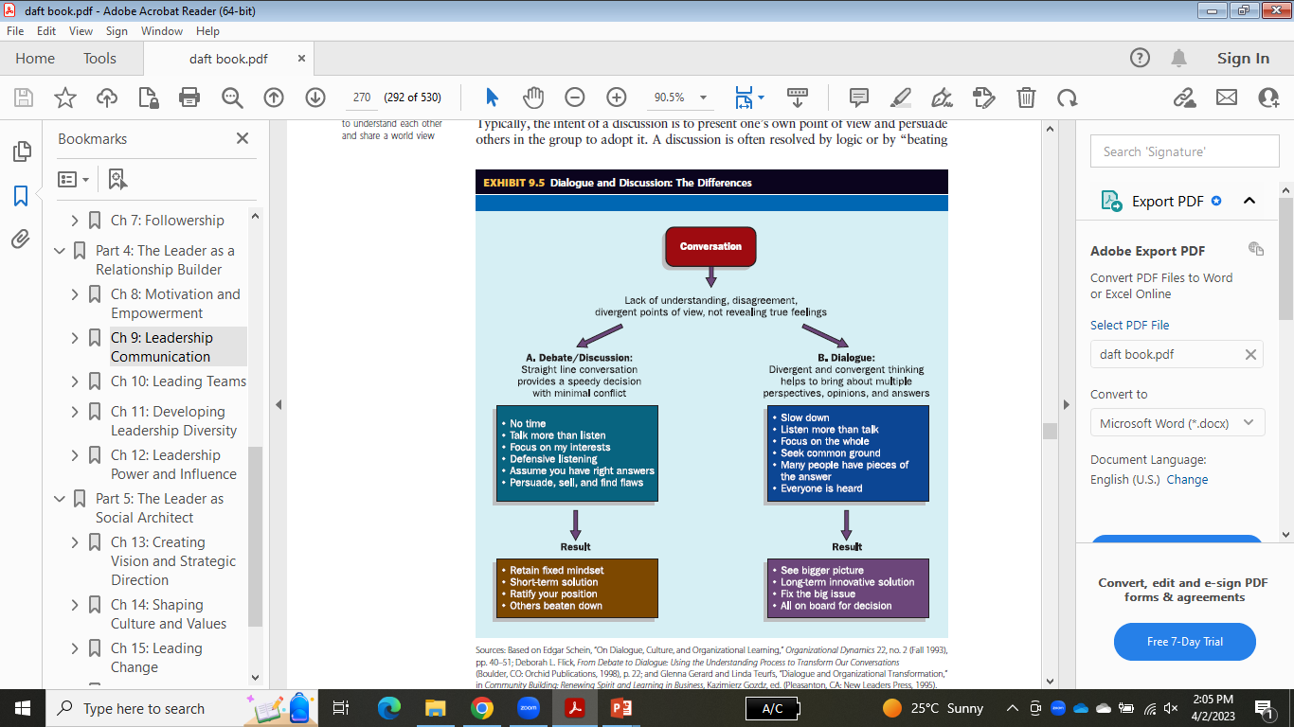

Slide 15
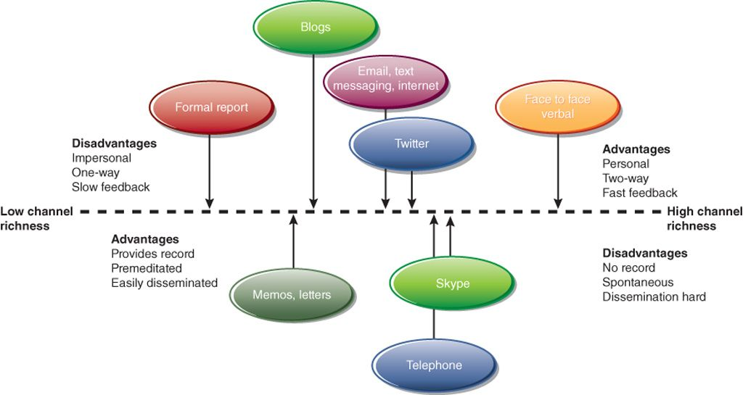
CONTINUUM OF CHANNEL RICHNESS

Slide 16
THAT IS ALL FOR TODAY!!
Students be like:

